Slide 1
Ganges River Water Pollution
By:Grace Hollifield Alexandria Henderson, Carsen Baumgardner, Tanner Buffington, Heartley Twiggs, Alexandria Bryant, Emma Ingle,

Slide 2
A Little About The Ganges River
The Ganges River is also referred to as the sacred river. People from all over India come to bath in it, wash their clothes in it, and even put their deceased love ones in the Ganges River. Factories also put the sewage in the river.

Slide 3
Water Pollution
Water pollution really affects a lot of people in India, because most of the population rely on the river for so many reasons like food, water, and bathing.
A 2007 study found that discharge of untreated sewage is the single most important source of pollution of surface and groundwater in India. There is a large gap between generation and treatment of domestic waste water in India. The problem is not only that India lacks sufficient treatment capacity but also that

Slide 4
Water Pollution
Out of India's 3,119 towns and cities, just 209 have partial sewage treatment facilities, and only 8 have full wastewater treatment facilities. Downstream, the river water polluted by the untreated water is used for drinking, bathing, and washing.
During festival seasons, over 70 million people bathe in the Ganges over a few weeks to cleanse themselves from their sins. Some materials like food, waste or leaves are left in the Ganges for ritualistic reasons.

Slide 5
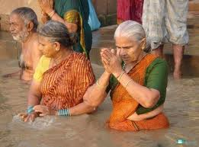
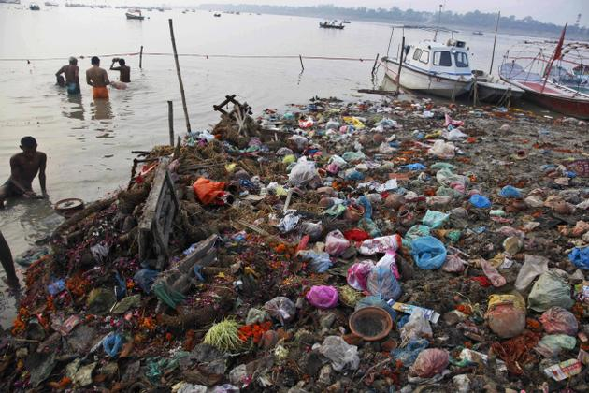
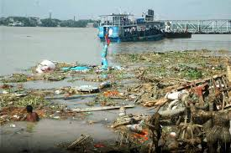
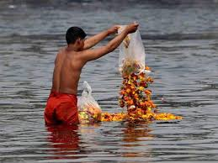
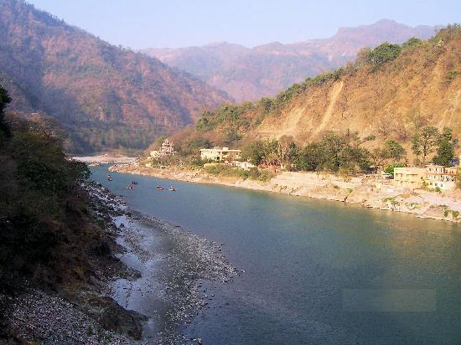
Images

Slide 6
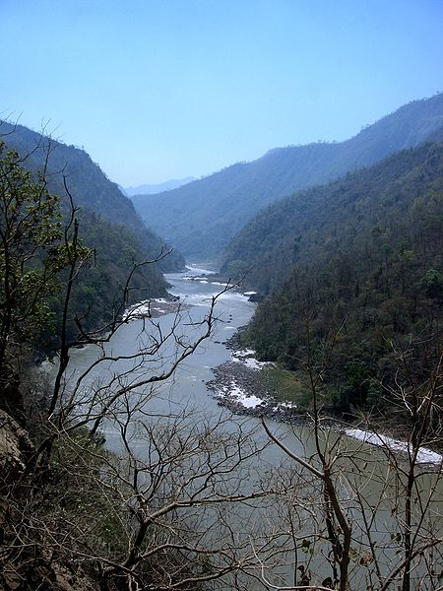
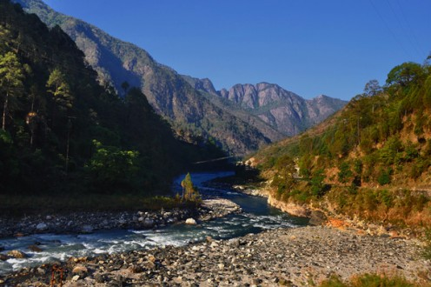
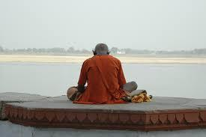
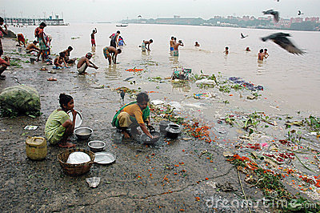
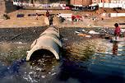
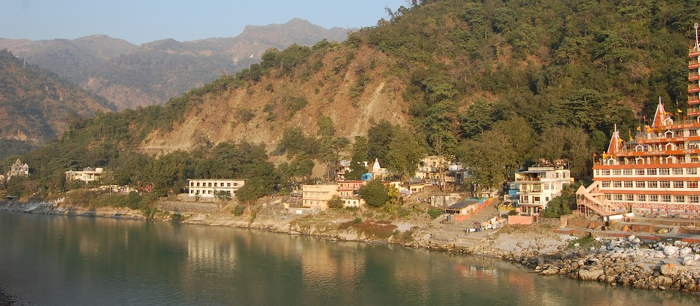
Images

Slide 7
Work Cited
http://www.all-about-india.com/Ganges-River-Pollution.htmlhttp://
en.wikipedia.org/wiki/Pollution_of_the_Ganges

